Slide 1
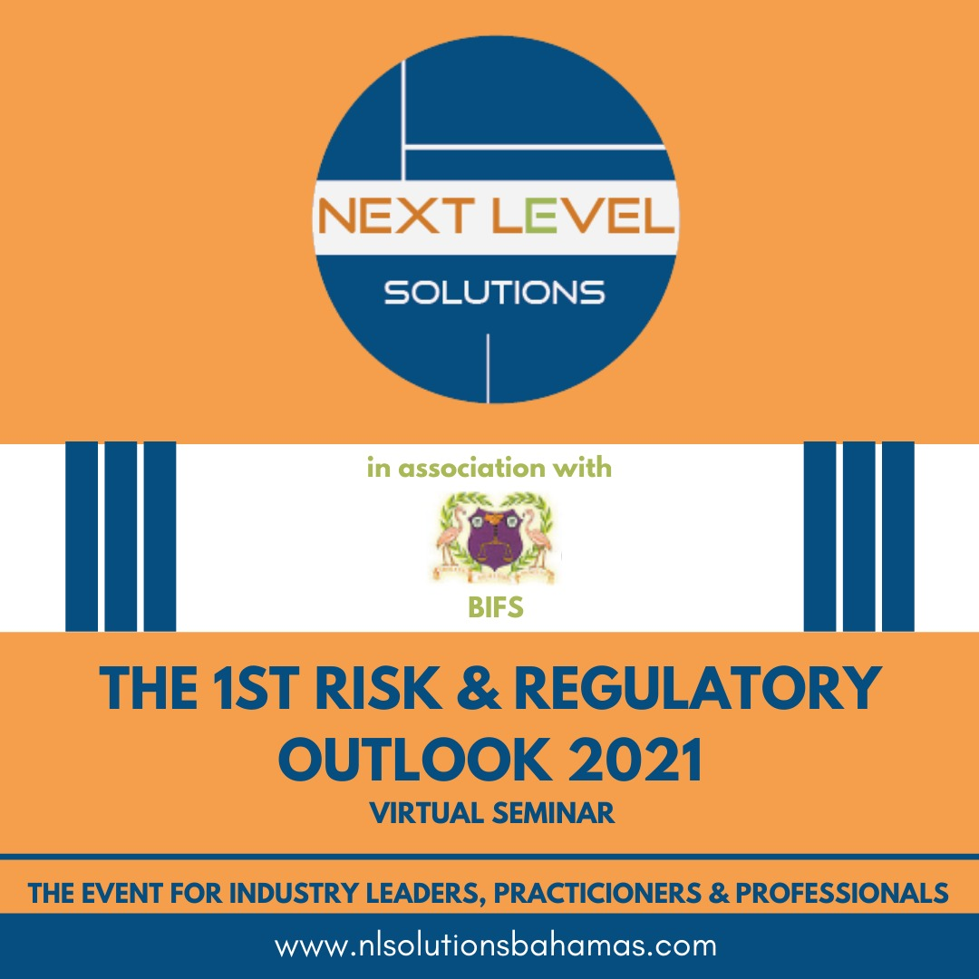
THE RISK DRIVERS – GOING TO THE ROOT OF RISK AND REGULATIONS
Hubert Edwards, MBA, FCCA, LLB
Managing Consultant, Next Level Solutions

Slide 2
RISK MANAGEMENT - MOVE FROM THE TRADITIONAL OUTLOOK!
. . . a systematic approach enabling an organization to consider all factors that threaten its ability to meet business objectives and implement appropriate risk management controls according to the organization’s risk appetite.
STRUCTURING AN ENTERPRISE RISK ASSESSMENTPROTOCOL: TRADITIONAL PRACTICE AND NEW METHODS
Mark Abkowitz
Janey Camp
RISK MANAGEMENT WHICH DOESN’T INFORM STRATEGY
IS A WASTE OF RESOURCES - NextLeveL

Slide 3
ERM DEFINED - COSO **** BE STRATEGIC, KILL THE SILOS OR SUFFER!
“…a process, effected by an entity's board of directors, management and other personnel, applied in strategy setting and across the enterprise, designed to identify potential events that may affect the entity, and manage risks to be within its risk appetite, to provide reasonable assurance regarding the achievement of entity objectives.”
Source: COSO Enterprise Risk Management – Integrated Framework. 2004. COSO.
RISK MANAGEMENT IS ALL ABOUT VALUE PROTECTION AND CREATION.
ANYTHING OTHERWISE IS AN INACCURATE PERSPECTIVE - NextLeveL

Slide 4
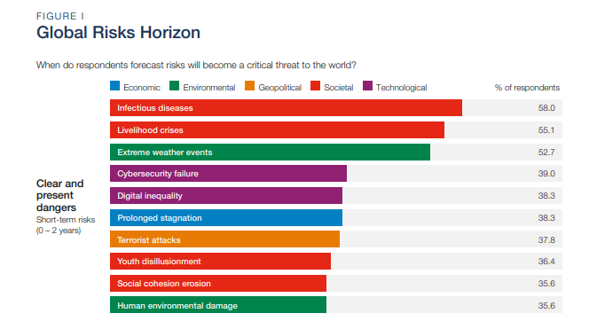
HORIZON SCANNING - (SOURCE: WORLD ECONOMIC FORUM) THIS IS OUR WORLD!

Slide 5
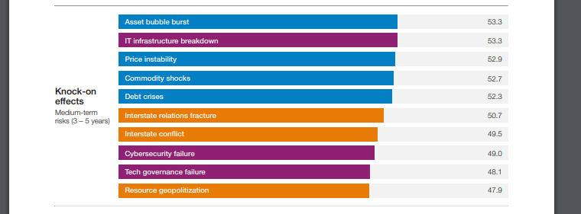
HORIZON SCANNING - WORLD ECONOMIC FORUM
IGNORE BIG PICTURE EXPOSURES AND TRENDS
AT YOUR PERIL. MANY ARE SIMPLY LEADING MACRO INDICATORS OF WHAT YOU WILL FACE SOON - NextLeveL

Slide 6
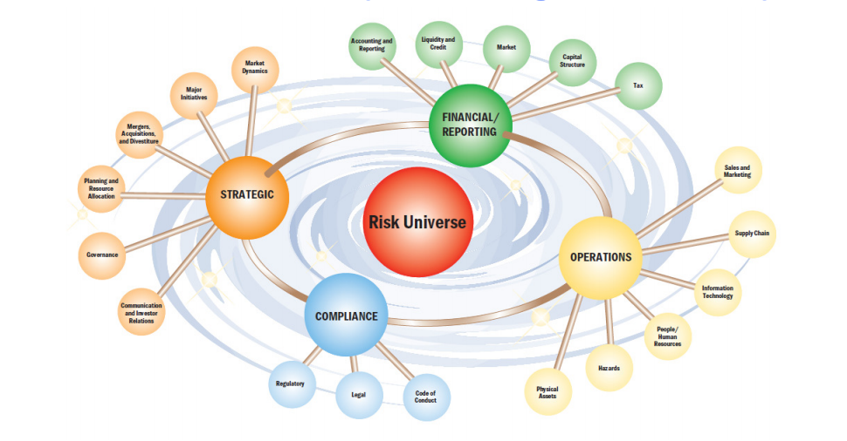
THE RISK UNIVERSE

Slide 7
RISK DRIVERS OF NOTE - “GLOBAL” DRIVERS (S&P Global)
Key Risk #1: Economic Disruption From COVID-19 Gets Worse Or Lasts Longer
Short-Term Support To Borrowers May Leave Longer-Term Overhangs
Digital disruption - risk, competitive implications, opportunities
Geopolitics : Economic nationalism and geopolitical tensions constitute one of the top risks
PANDEMIC AND FINANCIAL CRISIS – Credit and Liquidity / Asset Quality
EM vulnerability: Emerging market banking systems are exposed, by varying degrees, to local economies' heavy reliance on external funding, concentration on specific sectors (such as the hospitality sector or industrial or service exports to developed countries) or commodities (such as oil or gas). Another vulnerability in some countries is the lack of government capacity to continue providing meaningful support.
ESG: Investors and their stakeholders now demand more clarity on environmental, social, and governance (ESG) issues for decision-making

Slide 8
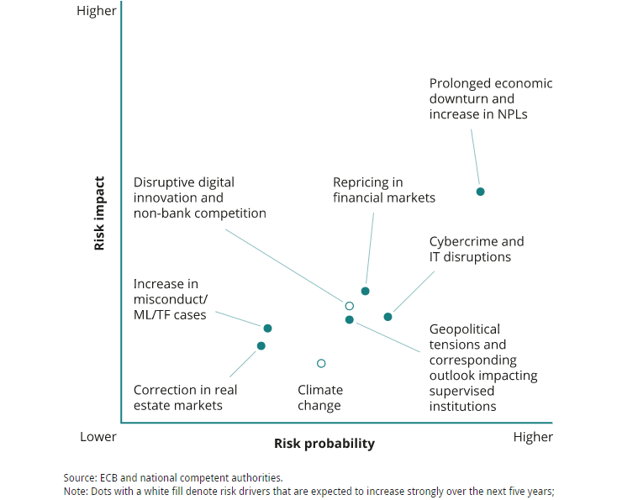
MAPPING RISK - (ECB) A COMFIRMING PERSPECTIVE

Slide 9
SOME OTHER DRIVERS
EMERGENCE OF NEW PRODUCTS & SERVICES - DIGITIZATION
CRYPTO CURRENCIES AND BLOCK CHAIN TECHNOLOGY
CYBER SECURITY RISK
EMERGENCE OF FINTECHS OR FINTECH LIKE ENTITIIES
CONVERGENCE BETWEEN FRAUD vs. AML
ENFORCEMENT - CORPORATE GOVERNANCE AND MANAGEMENT
CONVERGENCE OF GOVERNANCE – RISK - COMPLIANCE (GRC)
EUROPEAN UNION AND POTENTIAL BLACK LISTING
IFRS 9
IFRS 17 – INSURANCE CONTRACTS
AML/CFT COMPLIANCE
RECOVERY AND RESOLUTION PLANNING

Slide 10
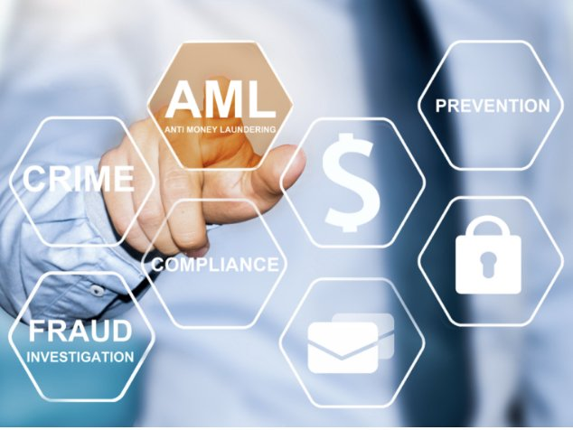
US AML ACT 2020 - LOOK OUT FOR SHADES OF PATRIOT ACT!

Slide 11
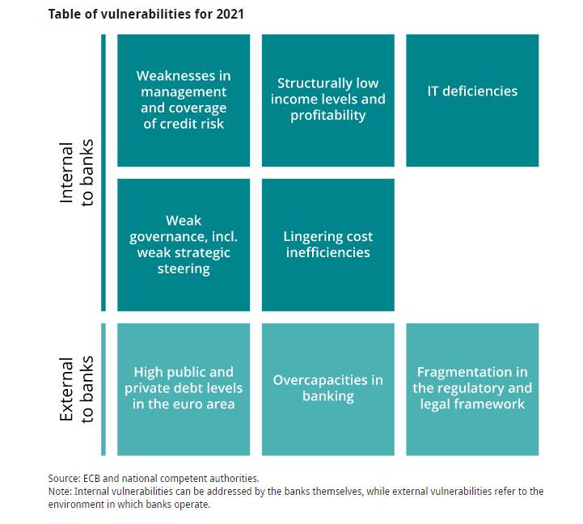
VULNERABILITIES FOR 2021 - THIS IS NOT JUST ABOUT FINANCIAL SERVICES!

Slide 12
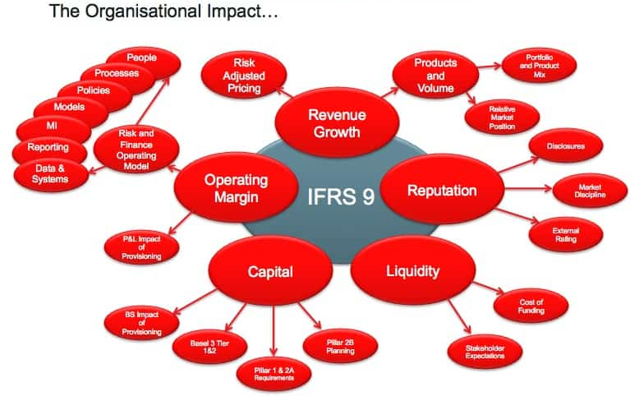
IFRS – 9 …. EXPECTED CREDIT LOSS
“Its implementation is not limited to an accounting project. The project has impacts on the organization, on the Risks and Finance functions, on the production of accounting, regulatory and prudential reporting, on all business sectors and activities.”
https://glceurope.com/

Slide 13
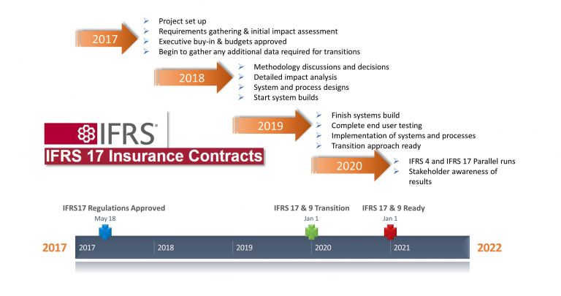
INSURANCE CONTRACTS - IFRS 17

Slide 15
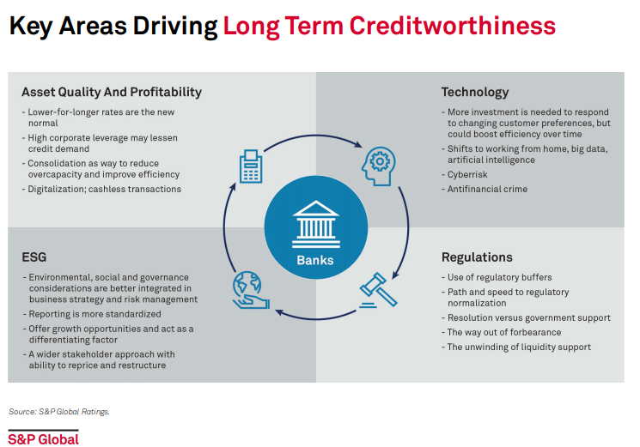
THE CREDIT RISK AHEAD

Slide 16
A REGULATOR’S PERSPECTIVE – FEDERAL RESERVES
“During recent years, the Federal Reserve has increasingly emphasized the importance of sound risk management processes and strong internal controls when evaluating the activities of the institutions it supervises.
This greater emphasis reflects the view that properly managing risks has always been critical to the conduct of safe and sound banking activities and has become even more important as new technologies, product innovation, and the size and speed of financial transactions have changed the nature of banking markets.
Accordingly, while an institution's financial performance is an important indicator of the adequacy of management, it is essential that examiners give significant weight to the quality of risk management practices and internal controls when evaluating the management and overall financial condition of banking organizations.”
SR 95-51 (SUP)
DIVISION OF BANKING SUPERVISION AND REGULATION
BOARD OF GOVERNORS OF THE FEDERAL RESERVE SYSTEM

Slide 17
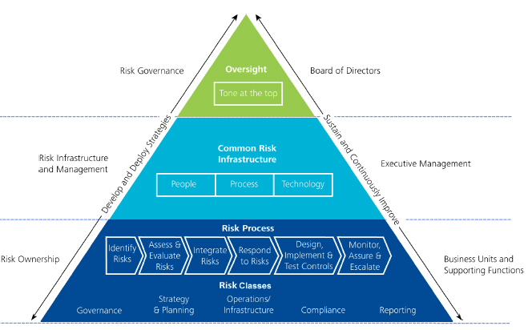
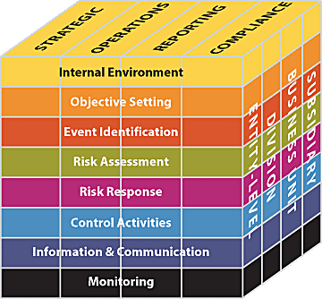
ERM - THE COSO / GOVERNANCE INFLUENCE
Entity objectives :
Strategic
Operations
Reporting
Compliance

Slide 18
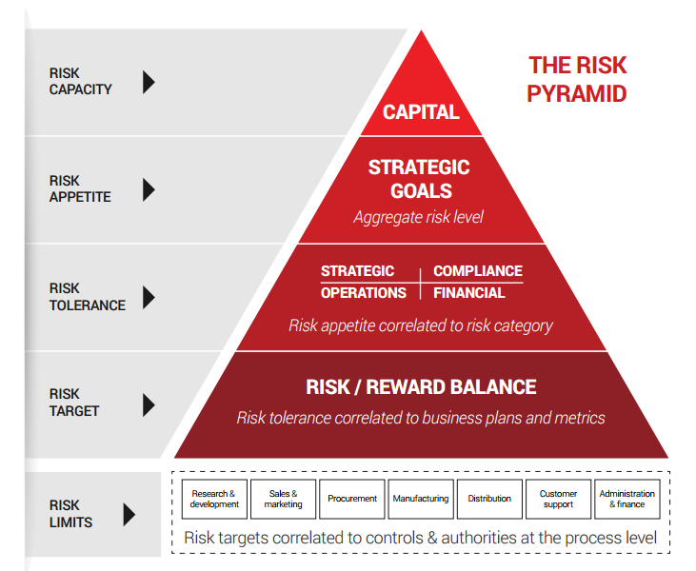
STRESS TESTING = ERM CAPITAL/SH VALUE

Slide 19
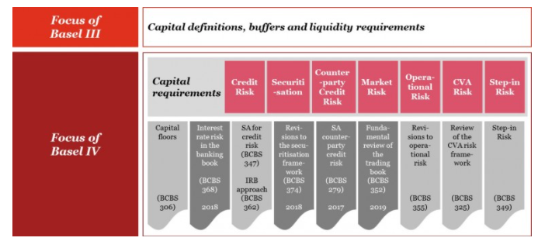
BASEL III & IV – INFLUENCE ON ERM

Slide 20
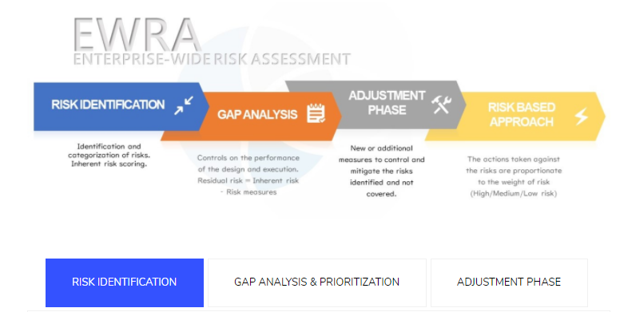
AML/CFT/KYC COMPLINACE - RBA

Slide 21
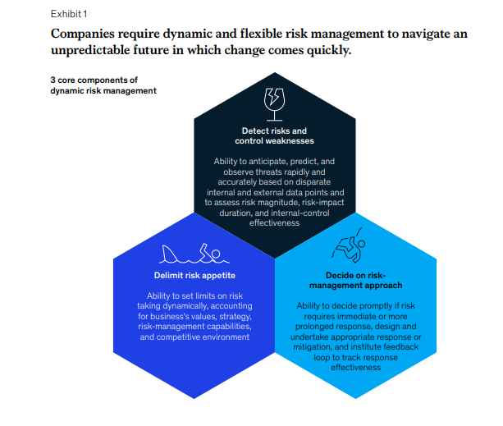
THE RESPONSE – DYNAMIC AND FLEXIBLE RISK MANAGEMENT
(SOURCE: McKINSEY)

Slide 22
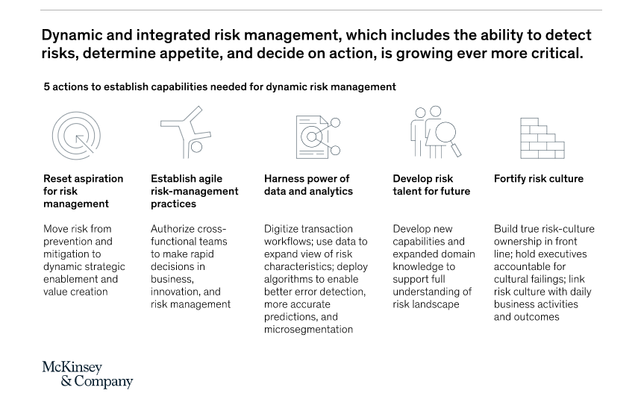
DYNAMIC & INTEGRATED RISK MANAGEMENT

Slide 24
CONTACTS
Hubert Edwards, MBA (Hons), FCCA, LLB (Hons)
Email: hubertwedwards@gmail.com
info@nlsoutionsbahamas.com
Telephone: (242) 376-8951
Website: www.nlsolutionsbahamas.com

