Slide 1
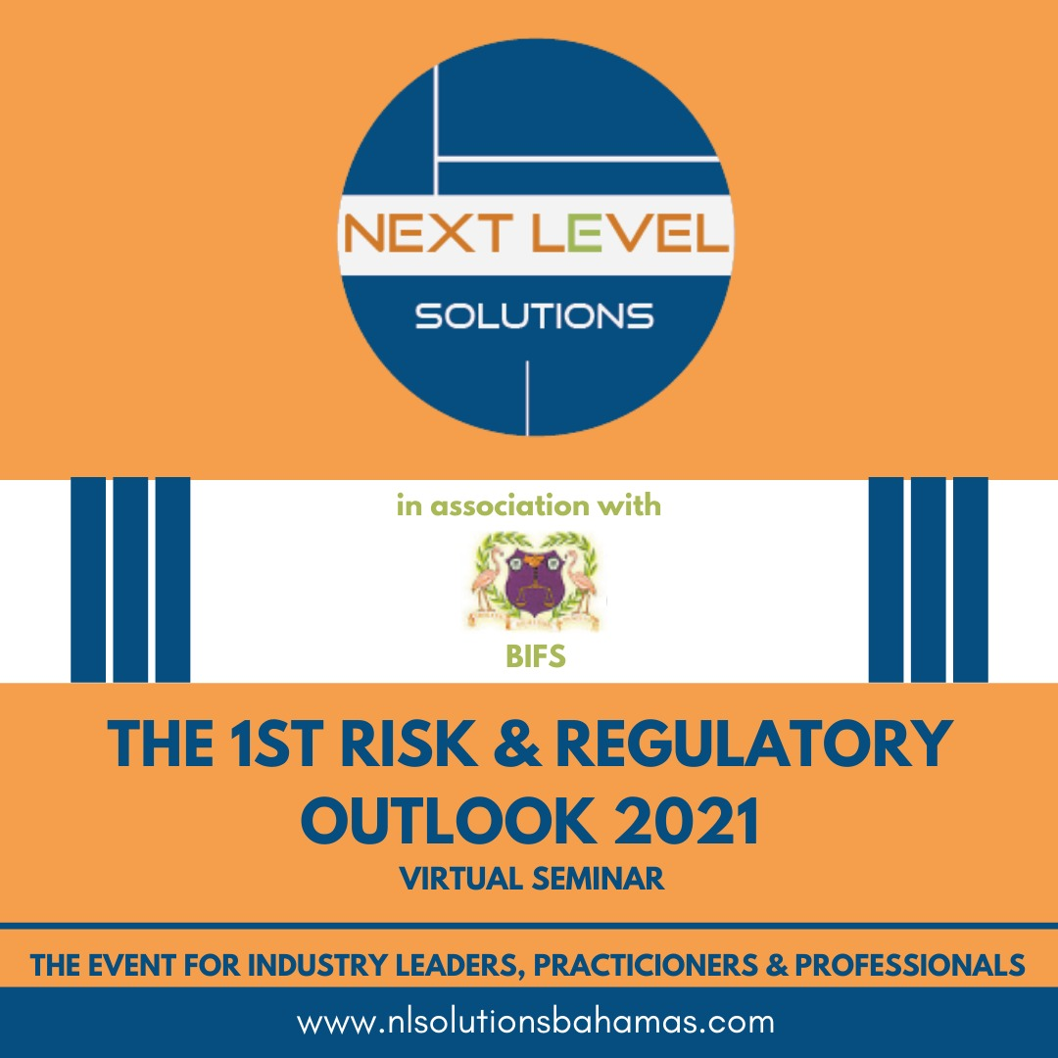
POTENTIAL RISK AND COMPLIANCE HURDLES – PRACTITIONERS BEWARE
Cheryl Bazard – Attorney; Compliance, Risk and Governance Expert

Slide 2
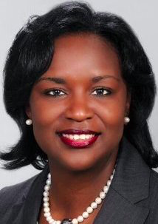
Meet the Speaker – Cheryl Bazard
Cheryl is an expert in the areas of Compliance, Corporate Governance and Anti-Money Laundering issues. She has served as Regional Director of Compliance for a pan Caribbean Bank with presence in 16 countries, including The Bahamas, Cayman Islands Barbados, Jamaica and Belize. She is also the founding President of The Bahamas Association of Compliance Officers and a former member of the Ethics Committee of the Bahamas Bar Association, former Chairman of the Port Authority, former Chairman of the Consumer Commission and Deputy Chairman of the Public Defenders' Commission. She has Diplomas with Distinction from The International Compliance Association in Compliance and Anti-Money Laundering and is a Fellow of that Association. Ms. Bazard is also a former Tutor at the Eugene Dupuch Law School and has served as a Course Director. Her public service in the community includes being a Board Member of the Bahamas Education Loan Authority and a member of the Disciplinary Committee of The Bahamas' Securities Commission.

Slide 3
On your marks!
This Photo by Unknown Author is licensed under CC BY-SA

Slide 4
Unpredictable and Evolving Environment

Slide 5
Economic conditions
impacting growth

Slide 6
Cybersecurity Threats

Slide 7
Off and Running
This Photo by Unknown Author is licensed under CC BY-SA-NC

Slide 8
Increased Risks
Stretched management and pressure to generate revenue may increase risk
Shelter-in-Place and remote work will lead to less oversight
Shelter-in-Place and remote work will have an impact on compliance processes:
- due diligence
- ongoing oversight & monitoring
- investigations
- reporting
- remediation
Compliance teams will be under considerable strain due also to pressure on their resources.
Government actors will be more involved in supply chain and procurement activity – more touchpoints with governments means more opportunity for improper payments
Shifts in supply chains may increase thus increasing risk unless proper vetting and screening continues… (increase sanctions/corruption risk and labor/human rights risk)

Slide 9
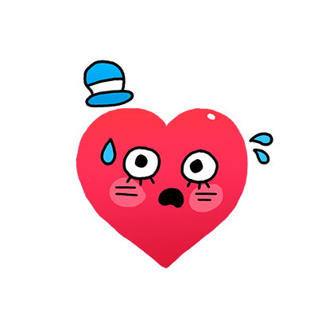
What are businesses most worried about?
Prolonged recession/ diminished economic activity
Surge in bankruptcies
Increased cyber attacks (remote working)
Unemployment
Cash flow issues
Fresh outbreak
Supply chain disruptions

Slide 10
RISK AND COMPLIANCE HURDLES
Execution Risks
Ambiguity and Uncertainty
Regulatory Risks and Regulatory Demands
Data Integrity
Inefficient Surveillance
Geopolitical developments
WFH Routines/Remote Oversight
Conduct Risk
Money Laundering 6AMLD
Disasters

Slide 11
How do you clear the hurdles?
This Photo by Unknown Author is licensed under CC BY-SA

Slide 12
How do you cross the finish line?
This Photo by Unknown Author is licensed under CC BY-SA

Slide 13
Your logo goes here

