Slide 1
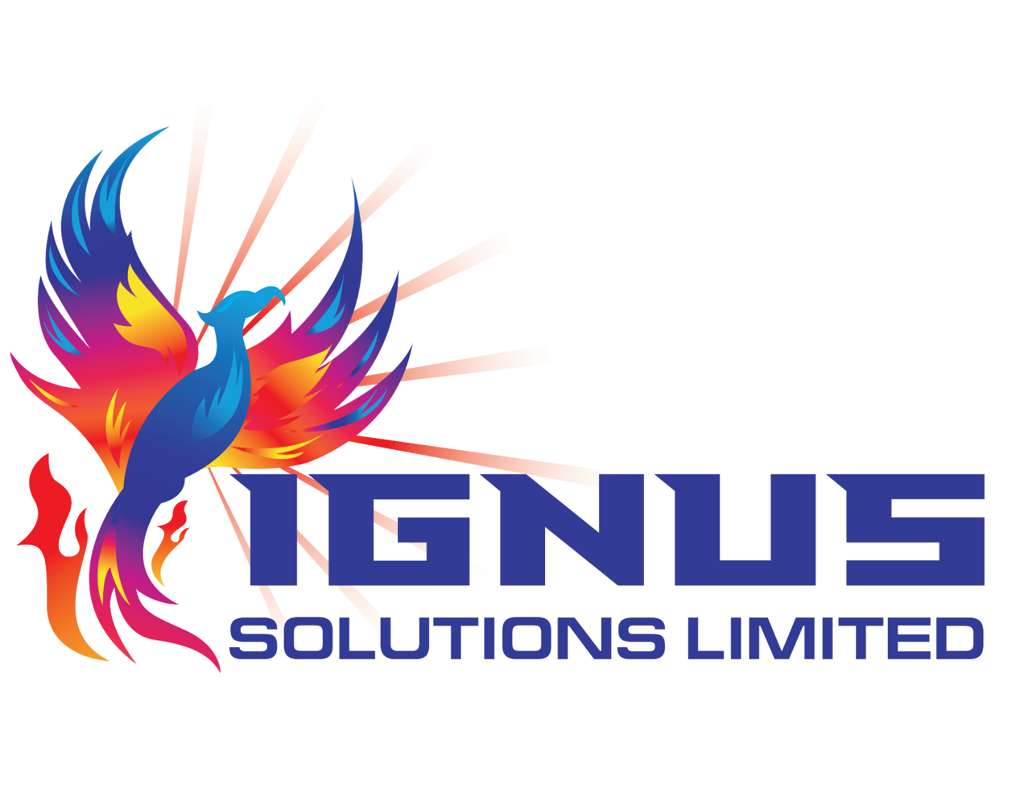
Crypto Risks A Look Beyond the Surface
Simone E. Martin, MBA, FICA, TEP, FCG

Slide 2
Overview
Introduction – Into the Waters.
Risks – Lurking in the Depths.
Pressure & Progress – Unfathomable Depths.
Future Focus – Charting the Deep Blue Sea.

Slide 3
Into the Waters!
So much more than ‘crypto’! It is important to understand the ecosystem (and how it is evolving).
Digital Assets
VASPs
NFTs
Smart Contracts
Minnows, sharks and whales, oh my!
Currents of change are strong… and shifting!

Slide 4
Lurking in the Depths
Criminals – the early adopters of any innovation.
Disruption now extends beyond traditional financial services and products.
Risk assessments are fluid, and not just for FinTech businesses focused on digital assets and other technologies.

Slide 5
Lurking in the Depths
Supranational Bodies
Bank of International Settlement - BIS
The United Nations - UN.
International Standard Setters
Financial Action Task Force – FATF
International Organization of Securities Commissions - IOSCO
Emerging Best Practices for businesses focused on digital assets and other technologies.

Slide 6
Unfathomable Depths
Blockchain Analytics.
Transparency vs Privacy.
Volatility and Risk.

Slide 7
Unfathomable Depths
Regulatory Clarity exists in narrow channels. The impact of past positions of some innovators may have contributed to the trench between innovators and regulators.
Capacity building must occur and must be ongoing.
Over-regulation is a thing that must be guarded against!

Slide 8
Charting the Deep Blue Sea
The Si of Regulation - YouTube
The METAVERSE… is it a real place?
Stablecoins and their future…
Tokenomics of everything!

Slide 9
Charting the Deep Blue Sea
DeFi and Financial Inclusion
ESG / Future Investment Strategies
APIs and other Compliance/Risk Solutions

Slide 10
Adapting and Adopting in a changing world…
… and being aware of those changes is critical to navigate these everchanging seas!

