Slide 1
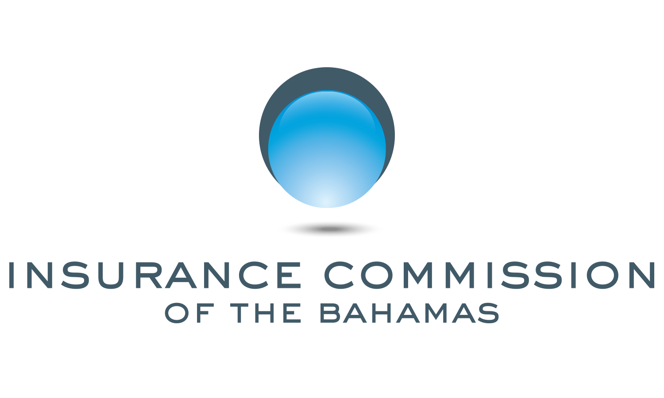
The Supervisory Approach
Charles W. Littrell
Inspector of Banks & Trust Companies
Bank Supervision Department
Central Bank of The Bahamas

Slide 2
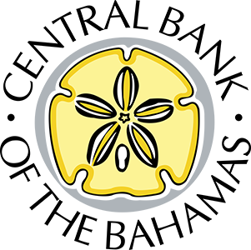
Bank Supervision Department: What We Do vs. What You See
What we do (mainly in private)
Entity entry/exit/mergers plus intervention
International engagement
Supervision
Regulation
What you see (hopefully)
Supervision, regulation, industry engagement

Slide 3
2022 Supervision
Supervision > Regulation
Exams, Directives, Requirements
Heightened focus: on-time reporting
Continued build for AML supervision

Slide 4
2022 Regulation
Several items
Recovery planning
Basel III capital
Auditors
Credit risk
Liquidity, Large exposures, Governance, AML, etc.
No major balance sheet/operational impacts

Slide 5
What about Covid?
Large domestic economic shock
Operational challenges under control
Prudential position is (surprisingly?) strong
Not out of the woods yet

Slide 6
Discontinuous risks
Large Nassau hurricane
“Four Horsemen” risks
Cyber-attack
Market shutdowns
AML scandal/blacklisting/de-risking

Slide 7
How can we Protect Ourselves?
Capital strength—regulation
Operational strength—supervision
Get ready for the hurricane
Avoid dubious clients

Slide 8
A Particular Issue: Domestic AML Overkill
Very few Bahamians are money launderers…
…so most Bahamians should be able to bank without undue problems
Presumption towards opening low risk accounts
Reliance upon reasonable KYC, then good account monitoring
No need to obsess over paper documents, utility bills, etc.

Slide 9
Email: BSD@centralbankbahamas.com

