Slide 1
Cyber Security Risk- Trends, Concerns, Opportunities
Shakera Rolle,
IT Security & Compliance Manager

Slide 2
Shakera Rolle IT Security & Compliance Manager, CBL
13+ Years in Cybersecurity
M.B.A., CISSP, CISM, CISA, CRISC
Love volleyball, carbs & working out
I have a beautiful and brilliant daughter
I am a proud Rotarian, and member of the illustrious Delta Sigma Theta Sorority Inc.

Slide 3
Agenda
Cyber Risk , Trends & Concerns
Remote & Hybrid Working Strategies
Digital Transformation
Increase in IoT Devices
Increase in Ransomware and Social Engineering Attacks
Opportunities for Building Cyber Resilience
Employee Security Awareness Training
Prioritizing Cybersecurity as a Business Decision
Strengthening Resilience Policies & Processes
Recruiting and Retaining Skilled Cyber Talent

Slide 4
Cybersecurity Statistics
According to Embroker, “Cybercrime will cost companies worldwide an estimated $10.5 trillion annually by 2025, up from $3 trillion in 2015.”
According to Check Point Research, cyberattacks increased 50% year-over-year, with each organization facing 925 cyberattacks per week globally. As per the statistics, businesses witnessed 50% more attacks per week in 2021 compared to 2020.
According to the Ponemon Institute and IBM’s Cost of a Data Breach Report 2021, the average total cost of a data breach increased from $3.86 million to $4.24 million in 2021. The report indicates a 10% year-over-year increase in average total cost, which is the highest ever recorded in the 17-year history of the report.
In 2021, around 300,000 new pieces of malware are created daily to target individuals and organizations.
According to CISCO’s 2021 Cybersecurity Threat Trends report, about 90% of data breaches occur due to phishing.

Slide 5
Cyber Risk Trends and Concerns: Remote & Hybrid Workplace
Concerns:
Access to corporate resources over unsafe Wi-Fi networks
Use of personal devices
Lack of physical security

Slide 6
Cyber Risk Trends and Concerns: Digital Transformation Concerns: Increased reliance on third-party services Regulatory complexities

Slide 7
Cyber Risk, Trends and Concerns: Increase in IoT Devices Concerns: Application and Software Real time data sharing Device Hygiene

Slide 8
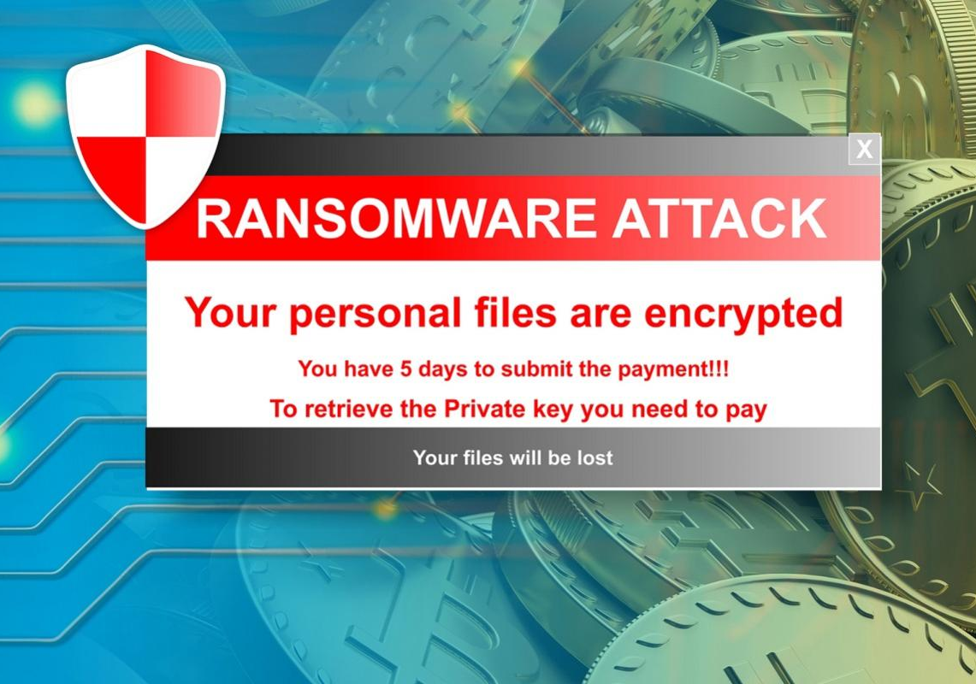
Cyber Risk Trends and Challenges: Increase in Ransomware and Social Engineering Attacks

Slide 9
Opportunities for Building Cyber Resilience
Employee Security Awareness Training
Prioritizing Cybersecurity as a Business Decision
Strengthening Resilience Policies & Processes
Recruiting and Retaining Skilled Cyber Talent

Slide 10
All employees, at every level of the organization should receive Security Awareness Training to ensure they have the skills required to identify and respond to an attack.
By providing end users engaging, thorough, and relevant training about types of attacks such as phishing and social engineering it reduces the likelihood that they falling victim.
Certain departments should also receive ongoing training, given the level of access they possess which makes them a prime target for hackers.
Notes:
creative ways to spice up training modules,ncluding gamification and learning management systems [LMS], and they can aid with mock testing to allow employees to learn from
general security-awareness training is the cornerstone of any effective information security practice; if people don’t know how to do their job securely, all the technology in the world won’t keep attackers at bay. One area where employee awareness is critical is in preventing phishing attacks.
HR and recruitment teams should be responsible for providing all employees with periodic (at least annually), adequate training. But remember, success depends on the full participation and support of senior management, because training needs to start at the top!
Great training can be delivered through online learning platforms and webinars. When you’re in the market for a new cyber security course, don’t just settle for an off-the-shelf training module! Your security-awareness course should be customised based on your organisation’s requirements, and should refer to organisation-specific structures, policies, procedures and business practices. Without this customisation, awareness training courses will be too generic and ineffective.

Slide 11
Prioritizing Cybersecurity as a Business Decision

Slide 12
Strengthening Resilience Polices and Processes
Information Security Policy
Password Security Policy
BCP and DRP Policies
Cyber Incident Response Policy

Slide 14
Contact:
Shakera.Rolle@cablebahamas.com

