Slide 1
EMERGING TRENDS AND IMPACT ON EMR, GOVERNANCE AND REGULATORY COMPLIANCE
HUBERT EDWARDS
PRINCIPAL
NEXTLEVELSOLUTIONS

Slide 2
How do these affect ERM, Governance and Regulatory Compliance? The trends are indicative and instructive ERM and Governance is about being best placed to meet objectives

Slide 3
The critical risk trends are here to stay Looking 10 years out is useful – but decide you own horizons [1, 3, 5 years?] There are skill shifting changes ERM practitioners need to look and understand more

Slide 4
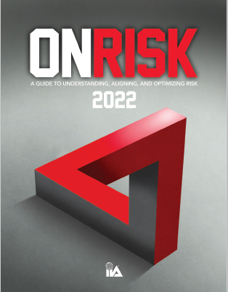
This is the new normal ERM must now be more fundamental, agile, used strategically, become more prominent The “one trick pony” is dead
Top 12 Risk for 2022
Cybersecurity
2. Talent Management
3. Organizational Governance
4. Data Privacy
5. Culture
6. Economic and Political
Volatility
7. Change in Regulatory Environment
8. Supplier and Vendor Management
9. Disruptive Innovation
10. Social Sustainability
11. Supply Chain Disruption
12. Environmental Sustainability

Slide 5
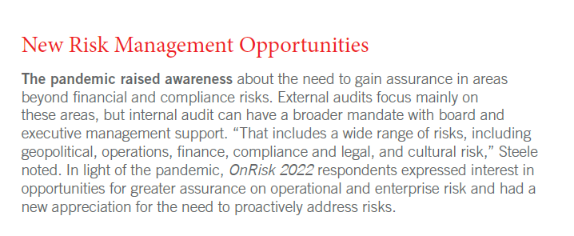
The dynamic and volatile environment is also about opportunities –ERM has a major role to play ERM is also about exploiting uncertainties for gain Improving the risk infrastructure is about adding value – better able to meet strategic objectives

Slide 6
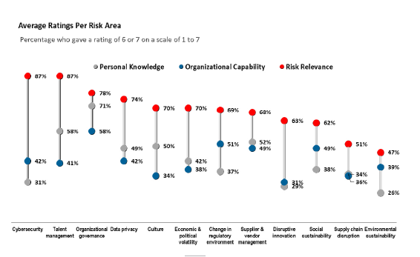
Improve organizational understanding of risks Enhance organizational capabilities Anticipate board and regulatory pressures Build confidence
The Gaps and GAPING

Slide 7
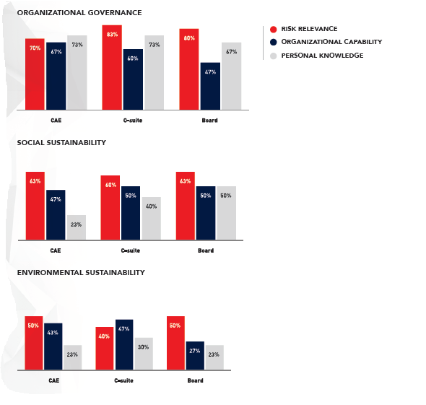
The differences between practitioners, Executives and Board are instructive.

Slide 8
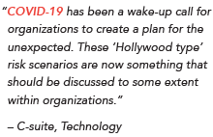
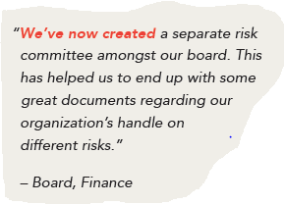
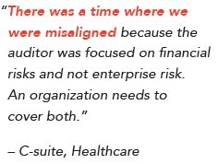
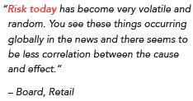
What is being said about risk in your organization? If there is no talk something is wrong!

Slide 9
For The Bahamas and rest of region economic risk must now become better understood
New waves of COVID will not derail the recovery as it transitions from pandemic to endemic.
Supply chain challenges will continue to disrupt key industries, but upward pressures on prices will abate. Wages gains will be strong but prove temporary, with inflation sequentially diminishing starting in the second half of the year.
Central banks will continue monetary tightening at varying rates, with market conditions worsening for riskier asset classes but avoiding major “taper tantrums”.
The withdrawal of pandemic-related emergency support means fiscal tightening worldwide.
The pace of the global expansion will slow, with regional divergence to continue.

Slide 10
For The Bahamas and rest of region economic risk must now become better understood Risk practitioners , executives and boards must appreciate the global economic environment
6 US growth will slow in 2022 to a still above-trend pace despite sharply waning fiscal stimulus, keeping labor markets tightening and interest rates on the rise
7 Mainland China will avert a housing market crash and a financial crisis but will grow below potential
8 A widespread emerging-market debt crisis remains a low probability
9 Momentum behind ESG issuance will continue to grow, but policy support to accelerate the energy transition will be mixed
10 Escalation of geopolitical tensions could create episodes of volatility between the US and mainland China

Slide 11
ERM starts with the tone at the top Corporate and risk governance demands board attention effective corporate governance is the “true north” Regulatory burden may demand support

Slide 12
Question time Ask the hard questions and answer them honestly Much about ERM is asking uncomfortable questions and address even more uncomfortable answers
Cybersecurity: Are organizations ready to manage cyber threats that could cause disruptions to operations and harm to their reputations?
Talent Management: Given the switch to remote operations and dynamic labor conditions, can organizations face the challenges of identifying, acquiring, training, and retaining the talent they need to achieve their goals?
Organizational Governance: Does governance — its rules, practices, processes, and controls — enhance or hinder achievement of objectives?
Data Privacy: In light of the increasingly complex and dynamic international regulatory environment, does the organization adequately protect sensitive data and ensure compliance with all applicable laws and regulations?
Culture: Given the rise of remote and flexible work arrangements, does the organization understand, monitor, and manage the tone, incentives, and actions that will drive the desired behavior from all employees?
Economic and Political Volatility: Does the organization monitor and address relevant challenges and uncertainties in a dynamic and potentially volatile economic and political environment?

Slide 13
Question time Ask the hard questions and answer them honestly Much about ERM is asking uncomfortable questions and address even more uncomfortable answers!
Change in Regulatory Environment: Is the organization, whether heavily regulated or not, prepared to address the risks in a dynamic and ambiguous regulatory environment?
Supplier and Vendor Management: How equipped is the organization to develop and monitor fruitful third-party relationships?
Disruptive Innovation: Can the organization adapt to and/or capitalize on disruption?
Social Sustainability: Is the organization able to understand and manage the direct and indirect impacts its actions have on individuals and communities?
Supply Chain Disruption: Has the organization built in the flexibility necessary to adapt to current and future supply chain disruptions?
Environmental Sustainability: Is the organization able to reliably measure, evaluate, and accurately report on its environmental impacts?

Slide 14
The ERM, Governance and Regulatory Compliance objective here? The fundamentals remain the same The path to effectiveness has gotten more vicious but also more exciting!
“A well-established enterprise risk management program that’s appropriately sized for your business and aligned to your strategies and objectives can help …
you proactively manage risk, reduce negative surprises, embrace risks to act on opportunities and bring value to your organization.
“Alignment across all levels of the organization on how risks are identified, assessed and managed continues to be critical.”
“..leaders find certain of these risks, specifically Organizational Governance, to be more relevant than others. Respondents also felt that organizations’ ability to manage certain risks were less in line with the relevance of the risk..”

Slide 15
ERM ,Governance, Compliance, CEOs, BODs, Regulatory Practitioners… ….Knew Normal!

